Slide 1
Our talk About D-Wave
by Alex Khan
July 21, 2020

Slide 2
Topics

Slide 3
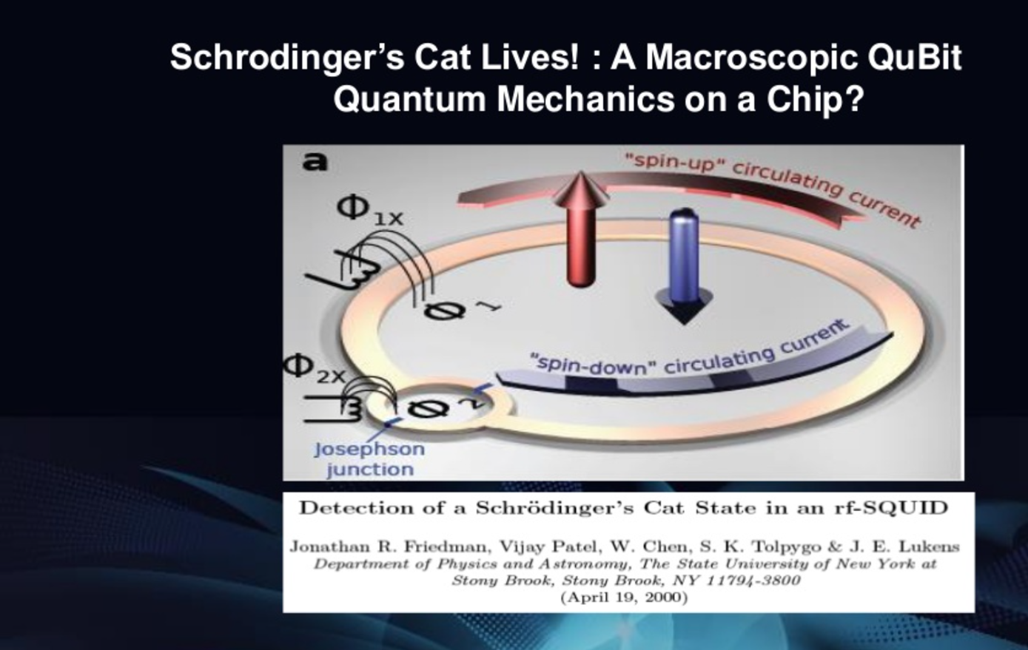
Annealing Quantum Computers

Slide 4
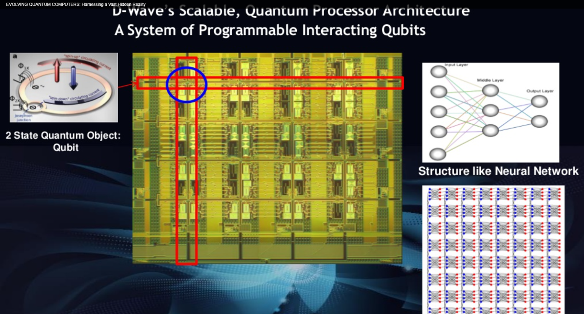
Annealing Quantum Computers

Slide 5
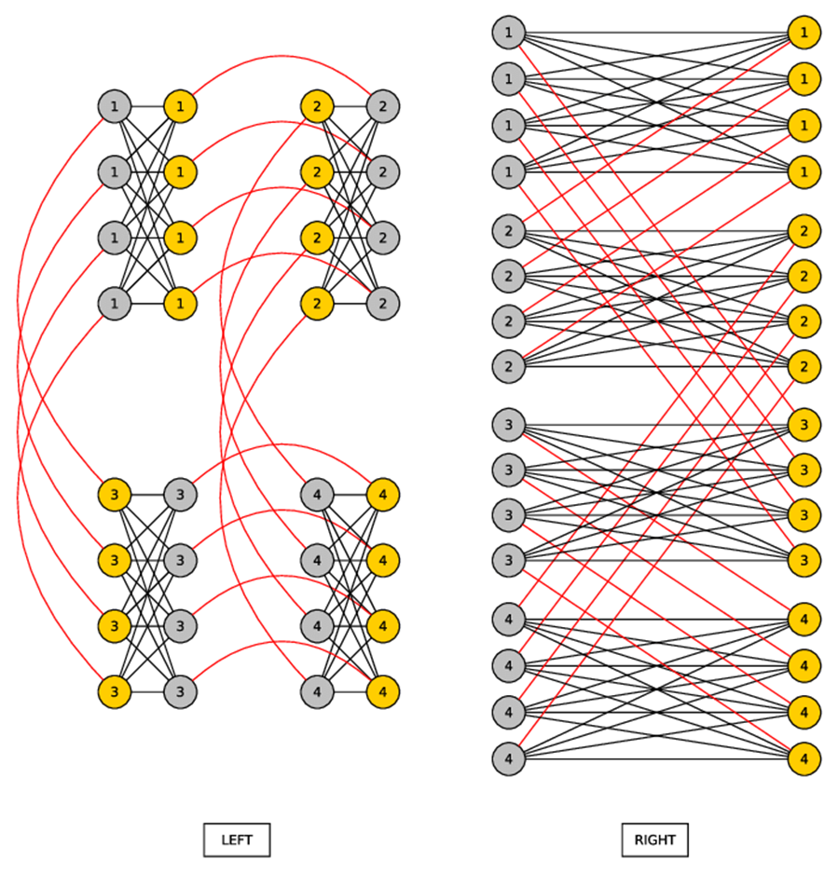
Annealing Quantum Computers

Slide 6
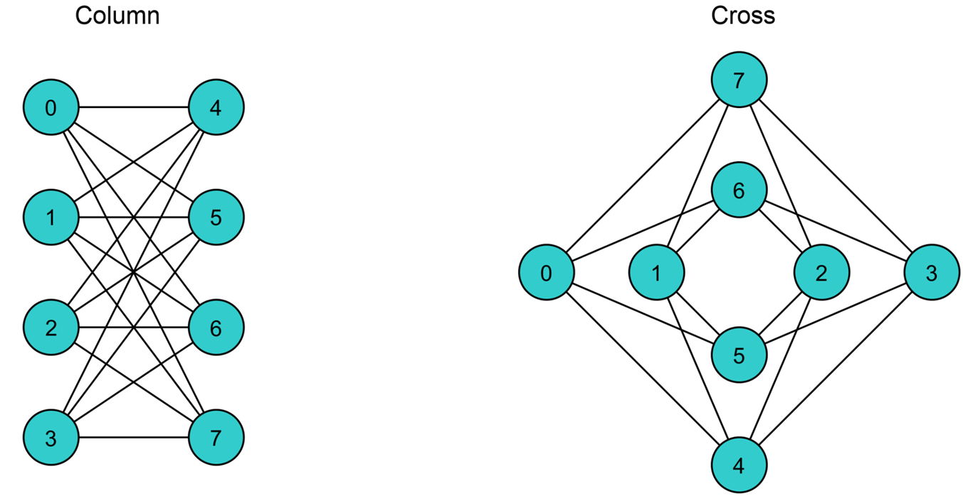
Annealing Quantum Computers

Slide 7
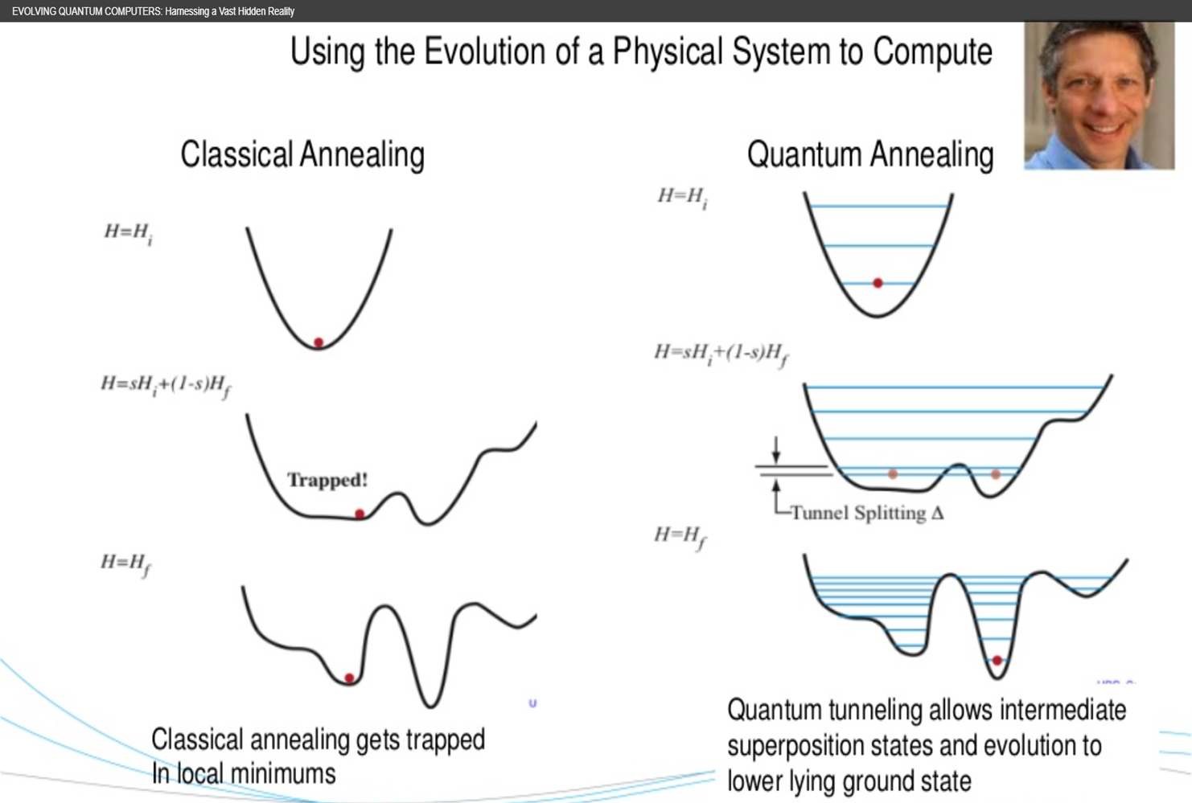
Annealing Quantum Computers

Slide 8
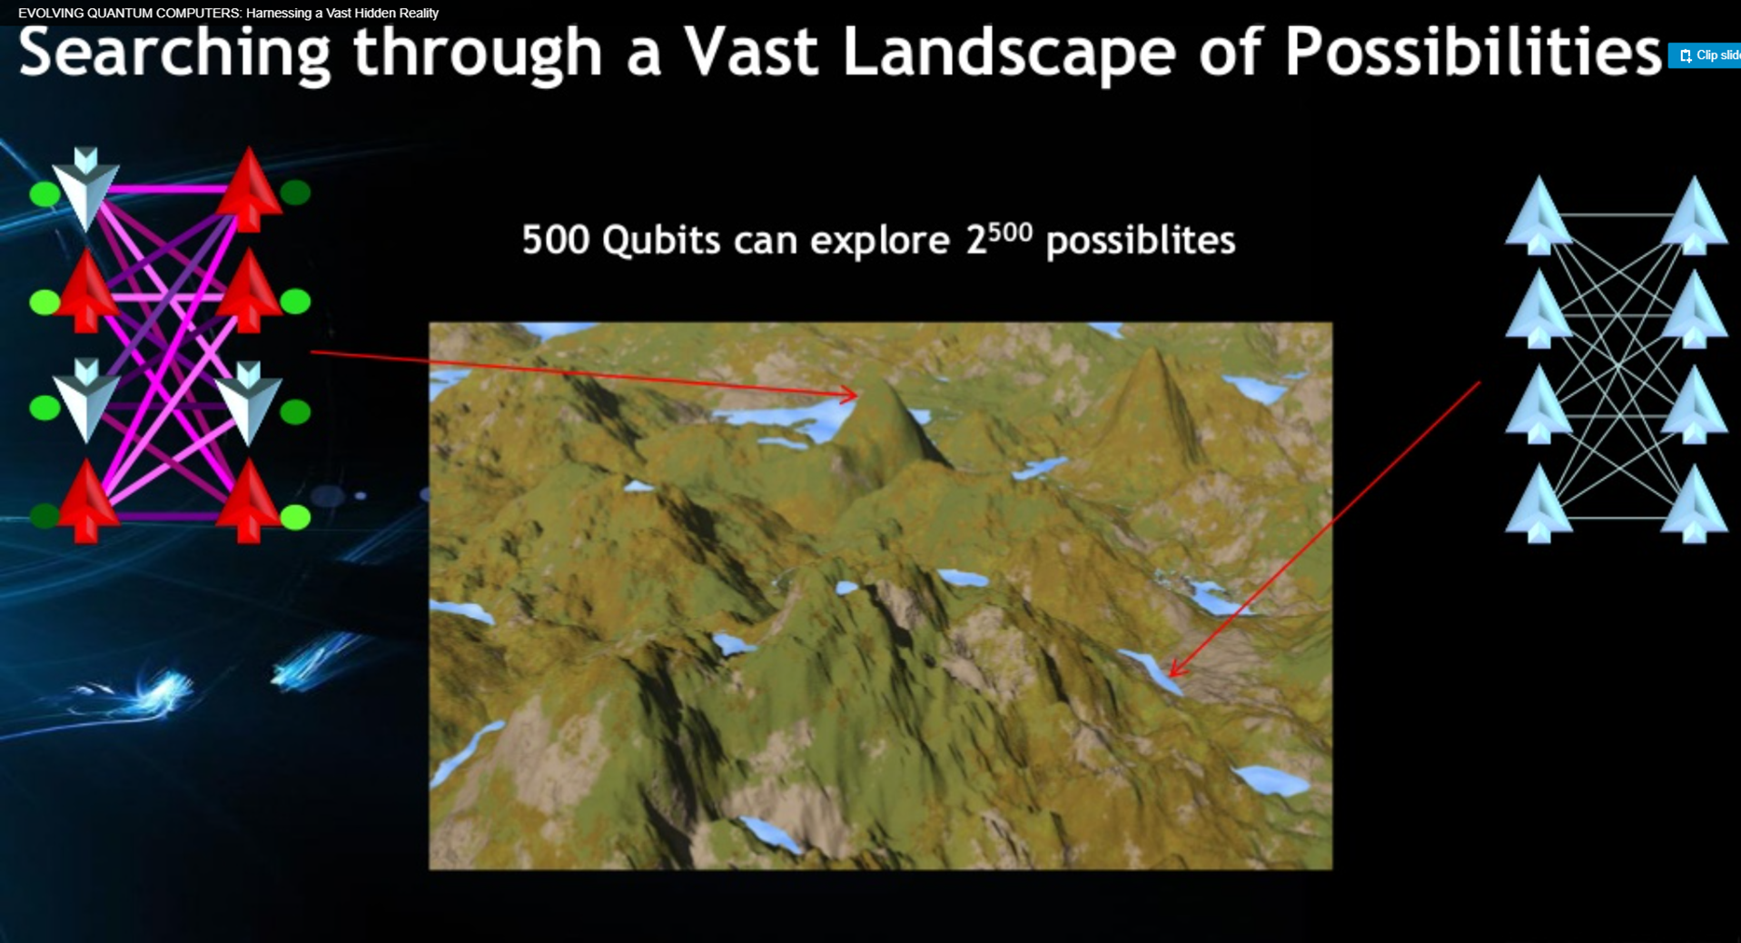
Annealing Quantum Computers

Slide 9
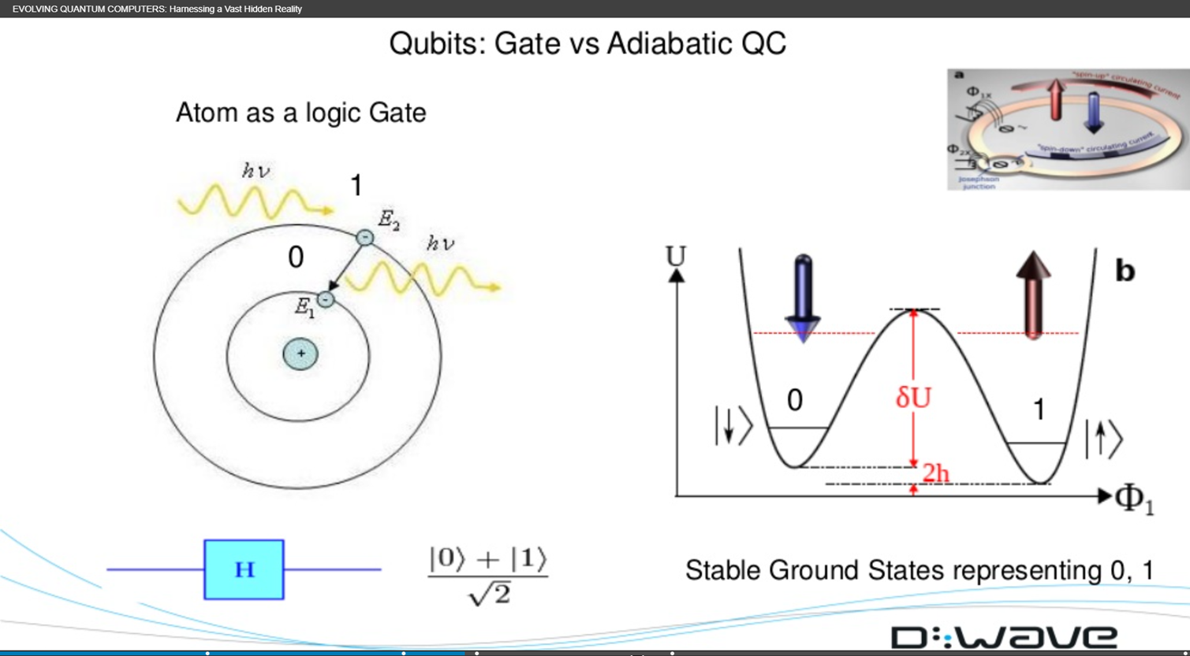
Annealing Quantum Computers

Slide 10
Questions

